Slide 1
at&A Training
Test automation
Continuous learning
Draft
ANZ Technology
May 2018

Slide 2
TEST AUTOMATION: ROLE DESCRIPTIONS AND COMMON PROGRESSION
Functional Background + Moderate Knowledge / Experience of Automation | Test Automation Specialists (Deeply Skilled, Technical) | Accenture Level
Quality Engineering Lead / Test Architect Senior test individuals with deep skills in Agile delivery, understanding of DevOps, test methodology, automation, environments, and data | Senior Automation Architect Senior automation individual with broad view of automation strategies, tools market, and how to apply automation across a lifecycle and within the layers of an application stack. Provide leadership and oversight to QE automation work, including setting standards for different types of automation and establishing the structure to be followed | L6
Automation Delivery Manager / Lead Individual providing day-to-day delivery leadership of the automation efforts, typically in larger teams supporting many apps, and often paired initially with a test automation architect to set up foundation | Automation Architect / Automation Technical Architect Focused on design and setup up of the technical infrastructure for successfully delivering automation, including integrations to DevOps tooling. Typically focused on mobilization activities, often the first 3 – 6 months of a project before transitioning to an automation delivery manager or technical lead, depending on scope | L7, L8 (Exp.)
Senior Quality Engineer Individual leading delivery of the automation efforts day-to-day, typically in smaller teams and could own an application or group of apps, often supported by one or more AEs | Automation Technical Lead Takes on a broader set of responsibilities, guiding more junior AEs in automation. Will have some automation development responsibilities, typically focused on the higher complexity tests or troubleshooting technical challenges, and in the technical lead role, could own a group of applications | L8 – L9 (Exp.)
Quality Engineer Responsible for build of the automation scripts and supporting elements (data, test design). Skilled in one of the next generation automation tools and could progress towards AE skills with appropriate training and experience | Automation Engineer (formerly SDET) Technically-deep individuals with a quality focus and deep knowledge of automation tools, including for non-UI and early automation (unit/assembly/integration), and moderate to advanced level of proficiency in the development language needed for the automation tool in use (if applicable). AEs may also contribute across multiple sprint teams | L9 – L11
With upskilling experience in the next generation (codeless) test automation tools. Provides onramp for building automation skills | Selenium Graduate New joiners with an academic background in software development and basic knowledge of automation and entry level skills in Selenium. SGs will typically be dedicated and part of a larger automation team, working alongside AEs to acquire skills and implement the work coordinated by the ATL | L11 – L13
Functional Tester
With technical upskilling/experience, including at least one development language and the DevOps tooling
Notes:
Types of roles / typically played on as x ata

Slide 3
Test Automation: Recommended Core Training Curriculum - 1 of 2
Selenium Graduate
Engineer (QE, AE)
Automation Tech Lead
Test Automation Architect
Legend:
General /
Overview
Quality Engineering Learning Path (link)
On Demand, Online
Test Automation Learning Board (link)
Virtual Instructor Led
Test Automation Academy
Onsite Instructor Led
DevOps Academy (link to scheduled sessions)
Apprenticeship Program
Intelligent Automation (link)
Testing in Agile Delivery with Test Automation and DevOps (link)
Pending ANZ Demand
Being Defined
Focused Training
Programs
Tricentis Tosca: Architect Training Program
Tool
Specific
(Core UI)
Tricentis
Tricentis Tosca: Automation Specialist and Engineer (AS1 link, AS2 link, AE1 link, AE2 link)
Tricentis Tosca: Intro Engineer (link to scheduled sessions)
Tricentis Tosca: Advanced Engineer (link to scheduled sessions)
Selenium
Build specialization in at least 2 tools (i.e. 1 major, 1 minor)
Selenium Academy: Basic Training
Selenium: Intermediate
Selenium / Sauce Labs Training (Selenium 101 link, Selenium 201 link, Selenium 301 link)
Worksoft
Worksoft Certify Fundamentals (link)
Worksoft Certify On Demand (link)
Worksoft Certify: Engineer (Intro session, Advanced session)

Slide 4
Test Automation: Recommended Core Training Curriculum - 2 of 2
Engineer (QE, AE)
Automation Tech Lead
Test Automation Architect
Legend:
Tool
Specific
(API)
On Demand, Online
SB
Smarbear Ready!API Training (add link)
Virtual Instructor Led
Onsite Instructor Led
CA
CA DevTest / AppTest Training (CA AppTest Trainig Path, CA DevTest Training Path)*
Apprenticeship Program
Tool
Specific
(Mobility)
Mobile Tools
Build specialization in at least 2 tools (i.e. 1 major, 1 minor)
See the detailed slide on available myL courses.
Instructor-led courses are available from the Digital Capability on request (Kuppathil, Divya divya.kuppathil@accenture.com
Note: see later slide for instructions on how to register for the CA Learning Portal

Slide 5
Test Automation: Additional Training Options: DevOps and Development
Engineer (QE, AE)
Automation Tech Lead
Test Automation Architect
Legend:
DevOps
Tooling
On Demand, Online
Git and Github (Udacity link)
Gradle for Android and Java - !st Half (Udacity link)
Virtual Instructor Led
Jenkins Training (Quick Start Course**, Certified Jenkins Engineer**)
Onsite Instructor Led
Learning Ansible (Part 1, Part 2, Part 3, Part 4)
Apprenticeship Program
Docker Learning Board (link)
Development
Java
Java Programming Basics (Udacity link)
Object Oriented Java (Udacity link)
JavaScript
Deep dive on specific development languages, based on need.
Intro to JavaScript (Udacity link)
Ojbect Oriented JavaScript (Udacity link)
Python
Intro to Python (Udacity link)
HTTP & Web Servers, w/ Python (Udacity link)
Note: Udacity linked above, given the amount of relevant courses and supporting lab content. Other training providers have offerings in these areas too.
**Jenkins courses link to a provider that has a small cost associated (https://linuxacademy.com/)

Slide 6
Test Automation: Additional Git Resources
Training Provider | Course | Description | Link
Udacity | How to Use Git and GitHub | In-depth, hands-on course on Git usage | https://www.udacity.com/course/how-to-use-git-and-github--ud775
Code School | Git (Path) | 4 courses to learn Git and Github | https://www.codeschool.com/paths/git
Code Academy | Learn Git | 2 hour overview course on Git | https://www.codecademy.com/learn/learn-git
 | Git Immersion | A guided tour that walks through the fundamentals of Git | http://gitimmersion.com/
Cheat Sheet | Link | Source
Git Cheat Sheet | http://training.github.com/kit/downloads/github-git-cheat-sheet.pdf | Github
Subversion to Git Migration Cheat Sheet | http://training.github.com/kit/downloads/subversion-migration.html | GitHub
Other helpful links:
https://help.github.com/articles/good-resources-for-learning-git-and-github/
https://developer.github.com/webhooks/
https://help.github.com/articles/using-pull-requests/
YouTube Channel | Link
GitHub Guides | https://youtube.com/githubguides
GitLab | https://www.youtube.com/channel/UCnMGQ8QHMAnVIsI3xJrihhg
Git Intro Videos | https://git-scm.com/videos

Slide 7
Mobility Training Courses - Details
Areas | Type | Course code | Learning Title | Delivery | Duration | Links
Mobile Testing | mylearning | A76000 | Digital Testing - Mobility Intro Courses | Online | 3 hours | https://mylearning.accenture.com/myl-ui/learner/activityDetails?referrer=search&activityID=1183588&source=myLearning&refresh=1442.047958604457
Mobile Testing | mylearning | REL70968 | Mobile Test Automation Using Perfecto Mobile | Online | 1 hour | https://mylearning.accenture.com/myl-ui/learner/activityDetails?referrer=search&activityID=1180907&source=myLearning&refresh=1810.7590962665308
Mobile Testing | mylearning | REL06926 | Mobile Application Testing Overview | Online | 0.5 hours | https://mylearning.accenture.com/myl-ui/learner/activityDetails?referrer=search&activityID=1141932&source=myLearning&refresh=1766.601819254046
Mobile Testing | mylearning | REL66708 | Mobile Application Usability Testing | Online | 1 hour | https://mylearning.accenture.com/myl-ui/learner/activityDetails?referrer=search&activityID=1178884&source=myLearning&refresh=1629.9137452029022
Mobile Testing | mylearning | A78418 | Digital Testing - Mobile Application Testing | Online (Group) | 5 hours | https://mylearning.accenture.com/myl-ui/learner/activityDetails?referrer=search&activityID=1184866&source=myLearning&refresh=1770.7490279677704
Mobile Testing | mylearning | A59409 | Overview of Mobile Application Security | Online | 0.5 hours | https://mylearning.accenture.com/myl-ui/learner/activityDetails?referrer=search&activityID=1172093&source=myLearning&refresh=1383.577554668364
Security Testing | mylearning | A59409 | Overview of Mobile Application Security | Online | 0.5 hours | https://mylearning.accenture.com/myl-ui/learner/fullLearningPath?channelValue=a3b39ea7-306a-4398-b17f-51dff37d7bd0&Referer=search
Network Virtualization Testing | mylearning | REL61524 | Mobile Application Network Simulated Testing | Online | 0.5 hours | https://mylearning.accenture.com/myl-ui/learner/activityDetails?referrer=search&activityID=1173203&source=myLearning&refresh=1159.9156479073356
Performance Testing | mylearning | REL06578 | Mobile Application Performance Testing | Online | 0.5 hours | https://mylearning.accenture.com/myl-ui/learner/activityDetails?referrer=search&activityID=1141804&source=myLearning&refresh=1310.466330842979
Location-Specific Testing | mylearning | REL58930 | Mobile Application Location Simulated Testing | Online | 0.5 hours | https://mylearning.accenture.com/myl-ui/learner/activityDetails?referrer=search&activityID=1171832&source=myLearning&refresh=1650.1682015951896

Slide 8
Quality Engineering: T-Shaped Skills Building
Automation Engineers and Architects are recommended to build skills in a T-Shaped fashion to support the needs of Agile delivery:
Analyst | Developer | Quality Engineer | Web Designer | System Engineer (DevOps)
Write Executable Specifications | Write Unit Test Code (xUnit) | Write Automated Tests (Test Code) | UX Design | CI/CD and SCM Tooling
Requirements Engineering | Write Production Code | Develop and Improve Test Frameworks | JavaScript, CSS, HTML | Python, Perl, Go, Bash
Write User Manuals | Design System Architecture, DB | Design Test Execution Infrastructure | Image, Icon, Logo Design | System and OS Admin
… | … | Test Design and Optimization | … | …
Broad
Deep
Building T-Shaped Skills
Gain mastery in one skill
Remain curious
Read broadly
Actively dabble
Watch Areas on the Journey:
Being a jack of all trades but master of none
Achieving the ability to write a simple test in 10 different tools, but lacking depth in any one tool
Moving on when it gets challenging in a tool/skill, rather than digging in deep to solve

Slide 9
Quality Engineering Learning Path

Slide 10
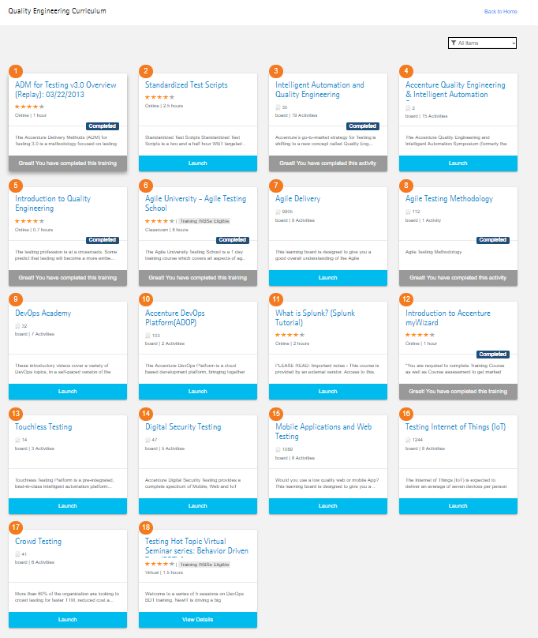
QE Learning Path
Link to myLearning

Slide 11
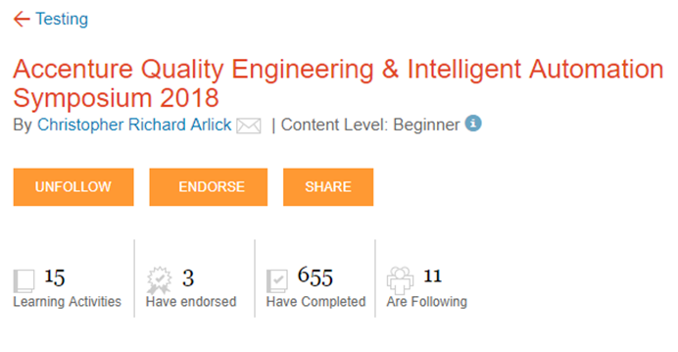
QE Symposiums
The Accenture Quality Engineering and Intelligent Automation Symposium (formerly the Accenture Testing Symposium) is our annual and exclusive, invitation-only client event designed for senior-level business and IT executives. The agenda for the 2018 event in North America featured sessions on emerging trends and innovation-led approaches across quality engineering, intelligent automation, digital testing, application security, modern engineering and talent and organizational transformation.
1) Introduction to the Quality Engineering and Intelligent Symposium 2018 : 16 min 27 sec
2) Aligning Quality Engineering to a Data- centric World - HfS Research : 39 min 35 sec
3) Combining AI and human ingenuity- Applied Intelligence : 30 min 34 sec 4) Enterprise Intelligent Automation : 34 min 4 sec 5) Teach and Test your AI systems : 25 min 51 sec 6)Automation trends and impact for intelligent enterprise- Panel Discussion : 24 min 31 sec
7) Industry X.O testing : 28 min 6 sec
8) Enterprise Applications of Blockchain Testing : 33 min 20 sec
9)Security by design- Responding to new risks : 30 min 6 sec
10) Security- Challenges today and future outlook : 29 min 29 sec
11)DevSecOps- Building the security mindset: 34 min 20 sec
12) Transformation- How big can you dream : 25 min 18 sec
13) Harnessing modern engineering for all applications : 31 min 32 sec
14) Developing the quality engineering workforce of the future : 42 min 48 sec
15) Transforming your IT organization : 26 min 46 sec
Link to the 2018 Symposium Learning Board

